Slide 1


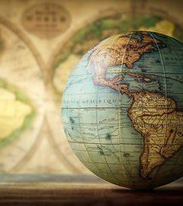

Cartography lecture #1
Ministry of Higher Education &Research Scientific
Northern Technical University
Engineering Technical College mosul
Geomatics Engineering

Slide 2
What is cartography? cartography the art and science of is the study and practice of making maps by graphically representing a geographical area, usually on a flat surface such as a map or chart.
2

Slide 3
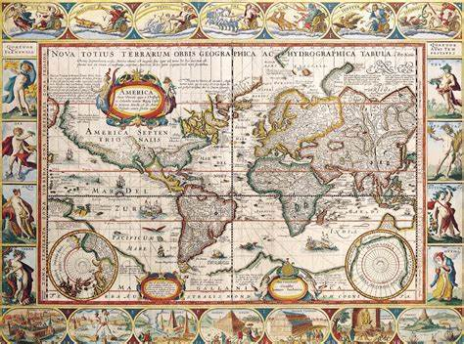
One of the world’s first maps ever

Slide 4
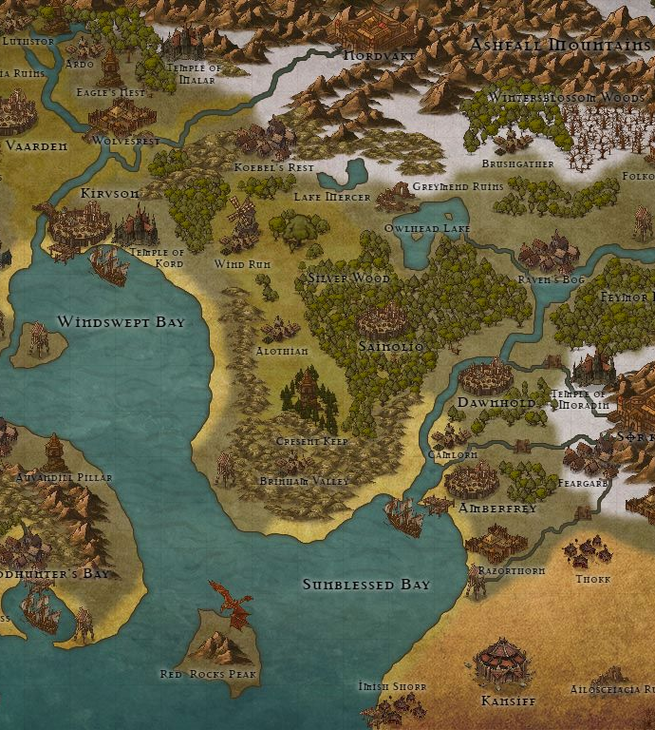
Why cartography is important?
To communicate geographic information in a graphic form as a digital image or a paper map (analog)
To position the surroundings, location and etc.
Graphics better than description —’A picture tells a thousand words’. • «Map is the second language of geography»-N.Baranski
4

Slide 5

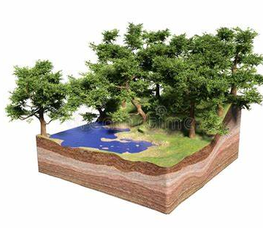
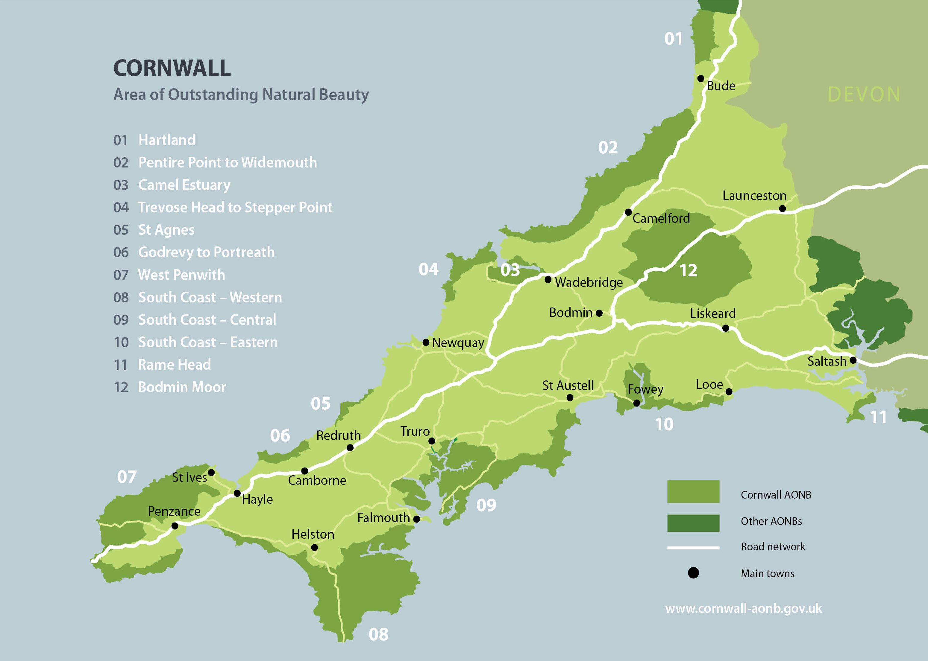
What is a Geographic feature?
The fundamental unit of geographic information is called feature.
A feature is an abstraction of real world phenomena associated with a location relative to the Earth. The main method of identifying and representing the location of geographic features is a map.
Real world geographic feature map

Slide 6
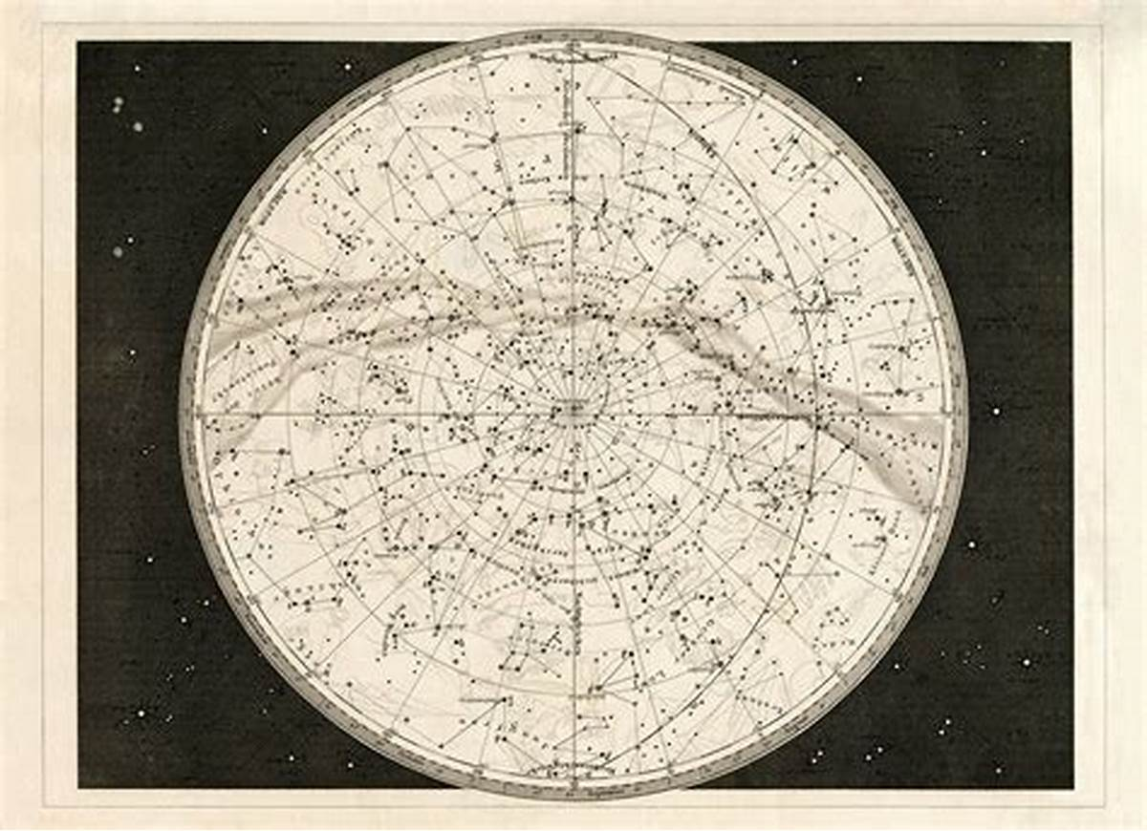
History of cartography and maps
Some of the earliest known maps date back to 16,500 BCE and show the night sky rather than the Earth.

Slide 7
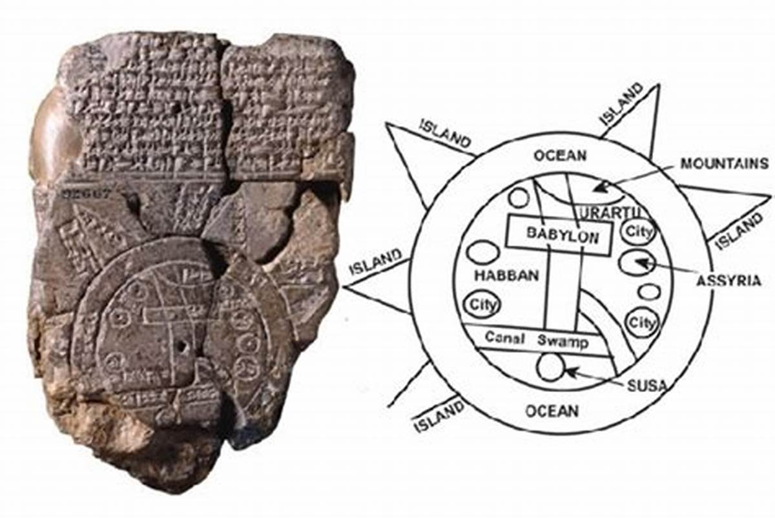
Maps were created in ancient Babylonia (mostly on clay tablets), and it was drawn with very accurate surveying techniques. These maps showed topographical features like hills and valleys but also had labeled features. The Babylonian World Map, created in 600 BCE, is considered to be the earliest map of the world. It is unique because it is a symbolic representation of the Earth.
History of cartography and maps

Slide 8
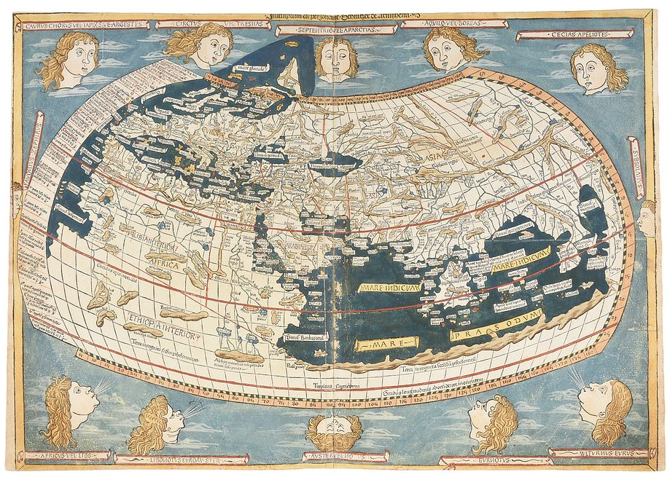
History of cartography and maps
Ancient Greeks created the earliest paper maps that were used for navigation, and to depict certain areas of the Earth. Anaximander was the first of the ancient Greeks to draw a map of the known world, and, as such, he is considered to be one of the first cartographers.
Potleym’s map of the world

Slide 9
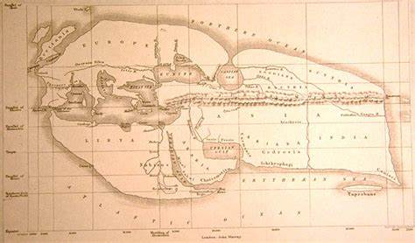
History of cartography and maps
Eratosthenes, and Ptolemy were other well-known Greek map makers. The maps they drew were based on explorer observations and mathematical calculations.
Many Greek philosophers considered the Earth to be spherical, and this knowledge influenced their cartography. Ptolemy, for instance, created maps by using a coordinate system with parallels of latitude and meridians of longitude to accurately show areas of the Earth as he knew it. This system became the basis for today’s maps, and his atlas "Geographia" is considered to be an early example of modern cartography.
Eratosthenes’s map

Slide 10
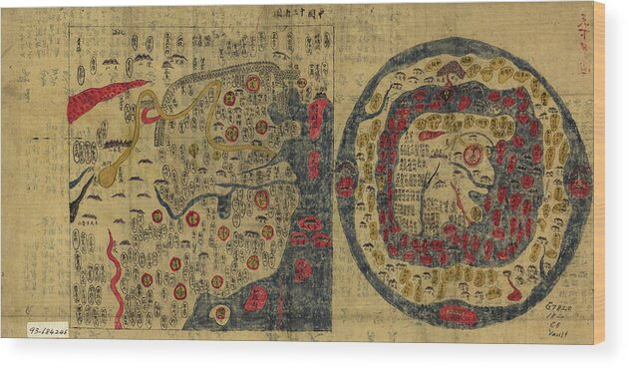
History of cartography and maps
Ancient Chinses maps date to the fourth century BCE and were drawn on wooden blocks or produced on silk. Early Chinese maps from the Qin State show various territories with landscape features such as the Jialing River system as well as roads. These are considered some of the world’s oldest economic maps.

Slide 11
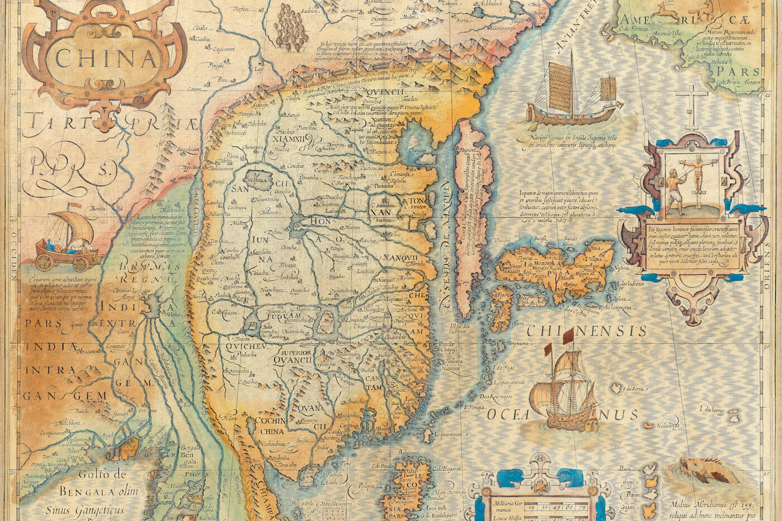
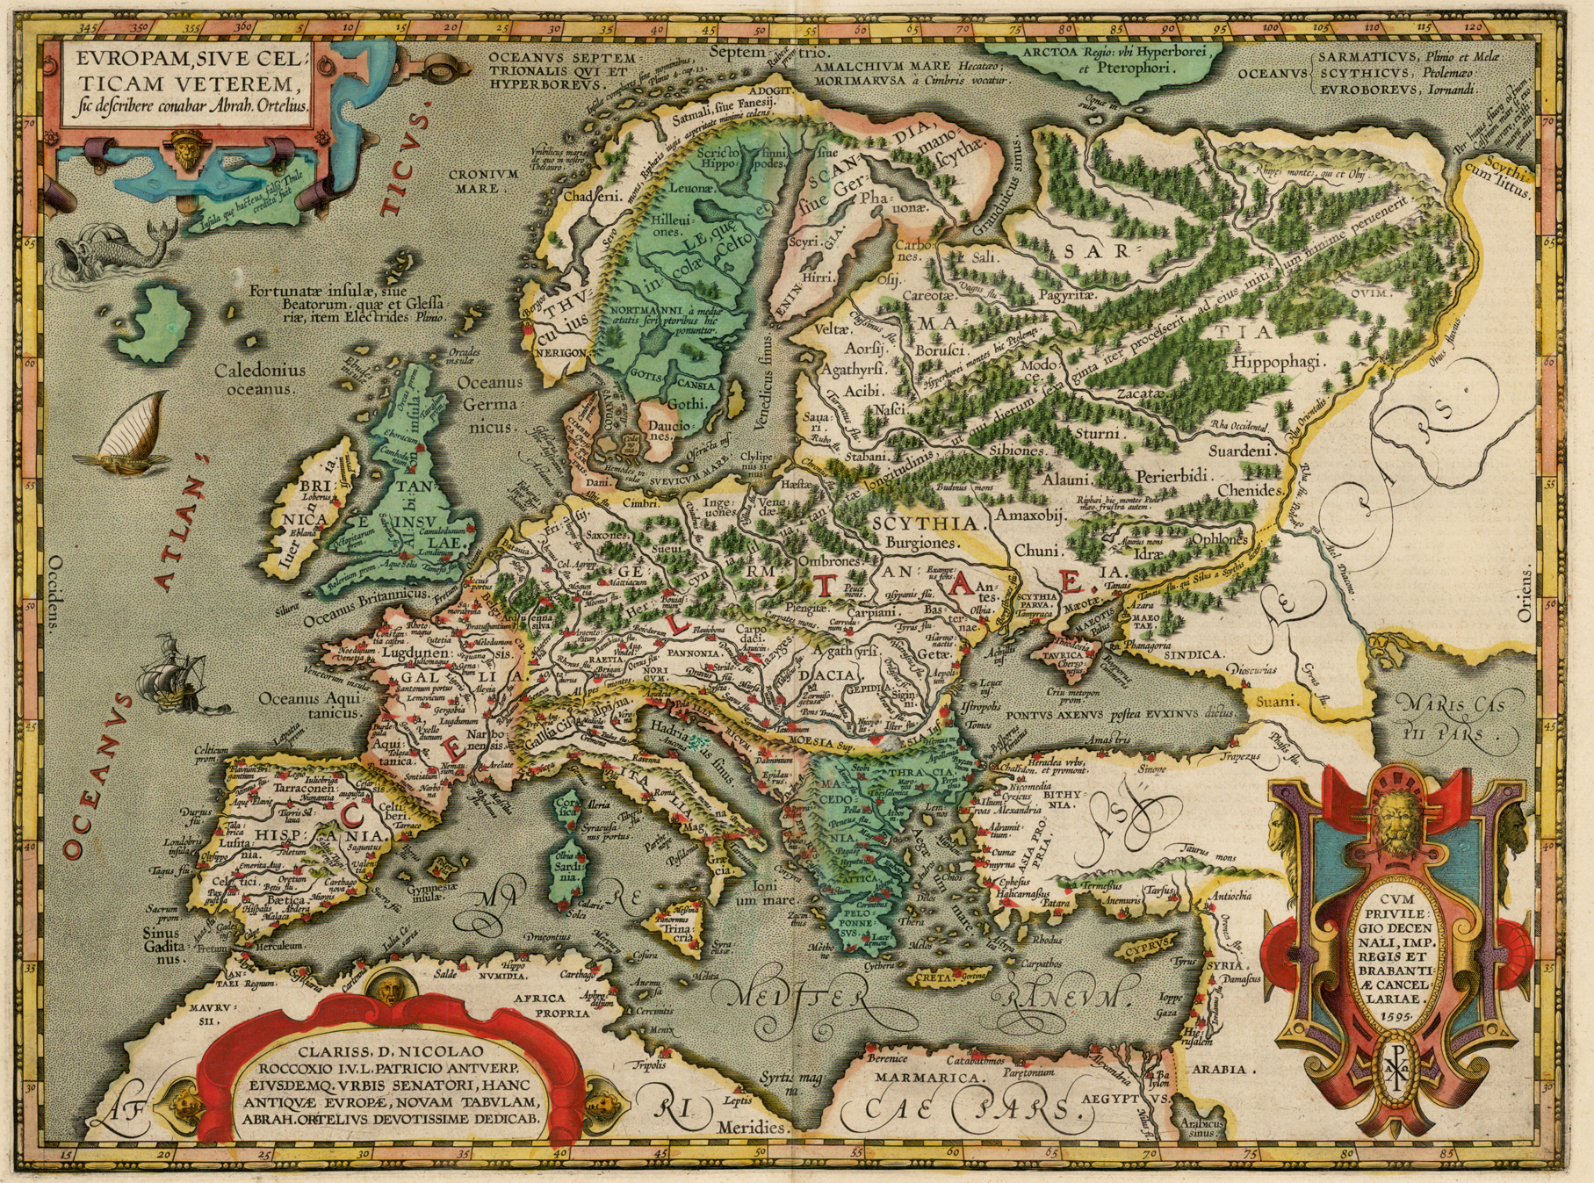
Cartography continued to develop in China throughout its various dynasties, and in 605 CE an early map using a grid system was created.
European early medieval maps were mainly symbolic, similar to those that came out of Greece.
History of cartography and maps

Slide 12
History of cartography and maps
Cartography developed in Europe during the Age of Exploration as cartographers, merchants, and explorers created maps showing the new areas of the world and they developed detailed nautical charts and maps that were used for navigation. In the 15th century, Nicholas Germanus invented the Donis map projection with equidistant parallels and meridians that converged toward the poles..
In the mid-1500s, Gerardus Mercator, a Flemish cartographer, invented the Mercator map projection. This projection was based on mathematics and was one of the most accurate for worldwide navigation that was available at the time. The Mercator projection eventually became the most widely used map projection and was a standard taught in cartography.

Slide 13
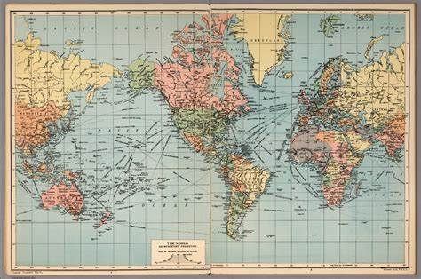
History of cartography and maps
The Mercator projection

Slide 14
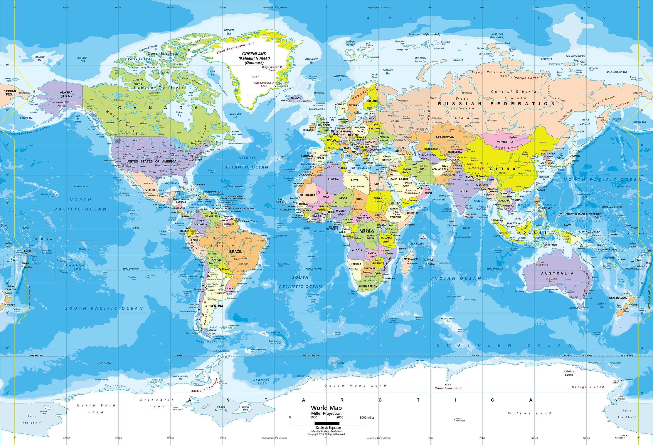
History of cartography and maps
Modern cartography began with the advent of a variety of technological advancements. The invention of tools like the compass, telescope, the sextant, quadrant, and printing press all allowed for maps to be made more easily and accurately. New technologies also led to the development of different map projections that more precisely showed the world.

Slide 15
History of cartography and maps
Maps are never realistic representations of the actual world. Field measurements are subject to errors of accuracy and precision.
No map can depict all physical, biological, and cultural features even for the smallest area. A map can display only a few selected features

Slide 16
In the 20th century, the use of airplanes to take aerial photographs changed the types of data that could be used to create maps. Satellite imagery has since become a major source of data and is used to show large areas in great detail. Finally, Geographic Information Systems (GIS) is a relatively new technology that is changing cartography today because it allows for many different types of maps using various types of data to be easily created and manipulated with computers.

Slide 17
What are the information sources for producing a map?
Land surveying
Aerial photography
Remote Sensing
GIS
others

Slide 18
there are two main types of maps:
those which summarise the actual landscape (topographic and general reference maps)
those which describe specific features using the landscape as a background or for context (all other maps – usually called thematic maps).
Types of maps

Slide 19
Topographic map
is a specialized cartographic representation that displays the physical features, elevation changes, and landforms of a specific geographic region. It offers comprehensive data on both natural and artificial elements, including mountains, hills, valleys, forests, bodies of water, highways, and buildings. The map employs contour lines to represent both the elevation and terrain characteristics.

Slide 20
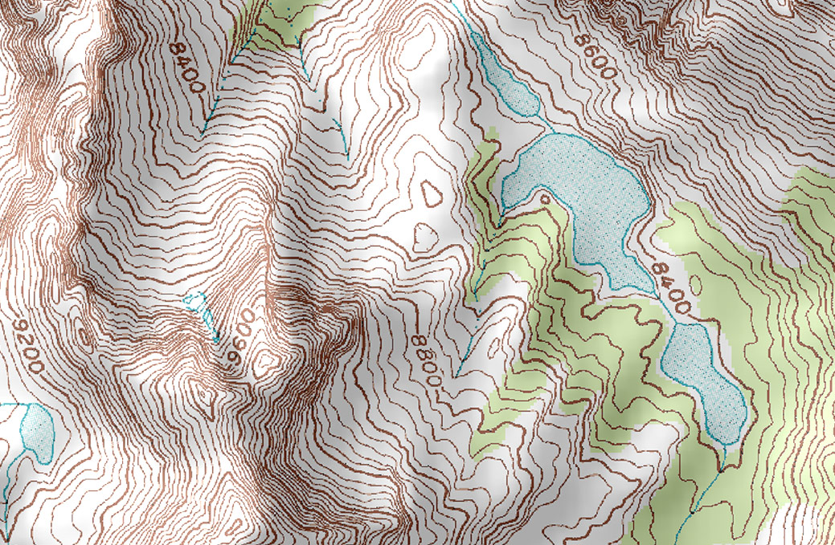
Example of topographic map

Slide 21
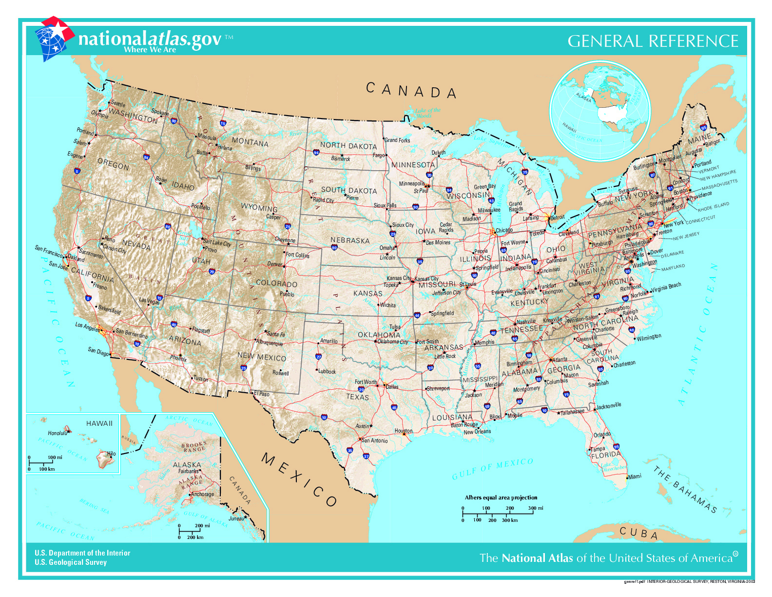
General reference maps
A general reference map is a simple representation of important physical features, both natural and man-made, in a specific area. Its main purpose is to provide a summary of the landscape, making it easier for us to discover and locate different places.

Slide 22
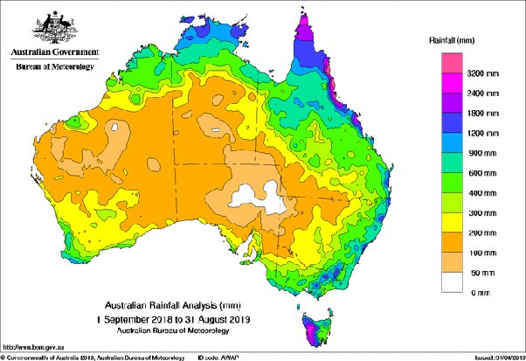
Thematic maps
Thematic maps are maps that focus on particular topics or phenomena, such as population density, rainfall and precipitation levels, vegetation distribution, and poverty.

Slide 23
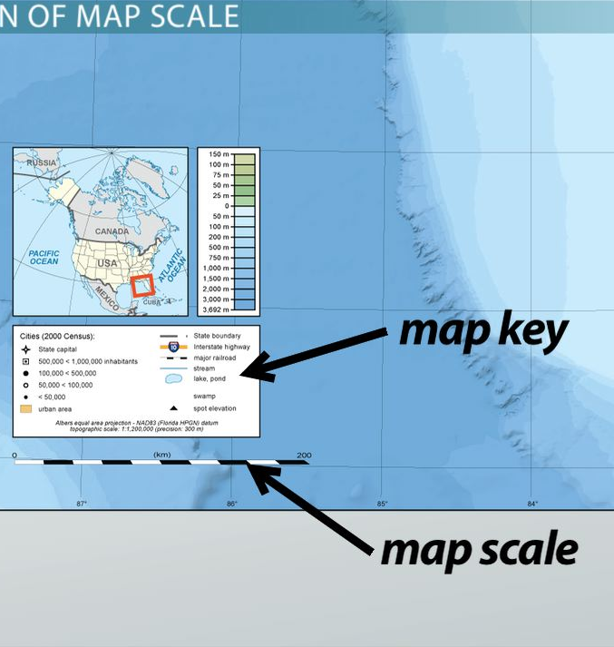
Classifications of maps based on scale
Small scale maps
Medium scale maps
Large scale maps
23

Slide 24
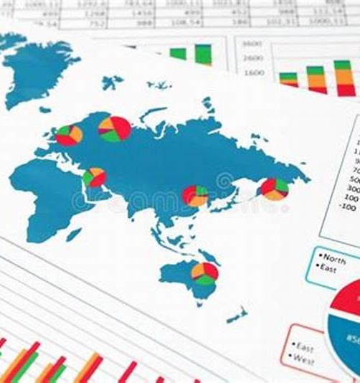
Classifications of maps based on their functions
General maps
Special purpose maps
charts
24

Slide 25
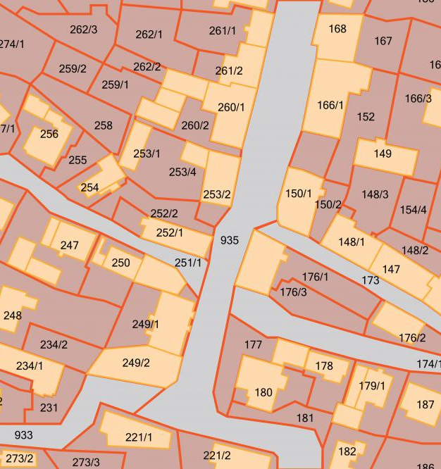
Classifications of maps based on their subject matter
Cadastral maps
Plans
Soil, vegetation, etc.
25

Slide 26




Thank you for listening.

